Slide 1
Powerpoint for report
Max Austin - Mada2

Slide 2
Motivation
Why UK Trade?
Large, rich dataset available from the CEPII BACI database
Personal interest in international trade and forecasting
Relevant Skills Developed
Deep learning using TensorFlow in both R and Python
Classification models:
Predict future trade based on historical features
Clustering techniques:
Group similar trade items or partners
Applied K-means to identify patterns

Slide 3
Research Questions
Can we forecast future UK trade data?
Total exports and imports
Will overall trade grow or decline?
Trade by product
Which goods will dominate?
Trade by partner country
Will new countries become more prominent?
Challenges of forecasting long-term trade
Economic shocks (e.g., COVID-19, financial crises)
Policy and geopolitical uncertainty (e.g., Brexit)
Structural changes in industry or consumer demand
Model limitations for long-term prediction

Slide 4
Overview of Data
The original dataset from the CEPII BACI database contained 258 million+ rows, covering:
Trade flows between 238 countries
Over 5,000 products using 6-digit Harmonized System (HS) codes
Annual data from 1995 to 2023
Preprocessing steps included:
Filtering rows where the UK was either importer or exporter
Merging similar products (e.g., combining 21 categories of “meat” into one)
Decoding numeric country and product codes into readable labels
Cleaning and reducing the dataset to around 5 million rows for focused analysis

Slide 5
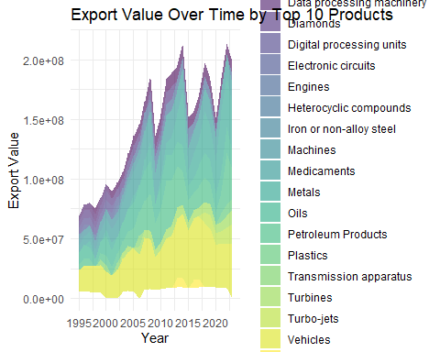
Export value by top products

Slide 6
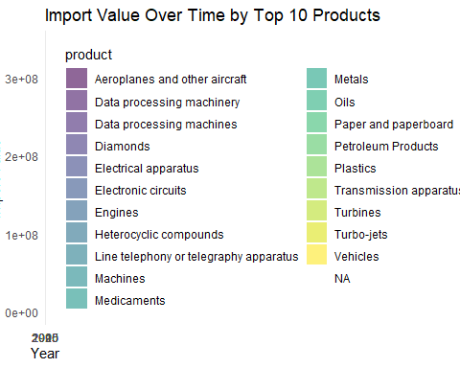
Import value by top products

Slide 7
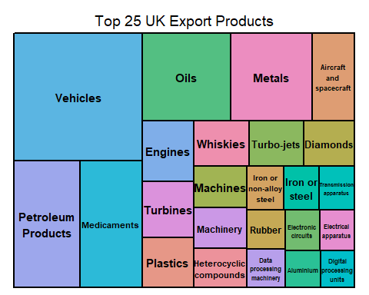

Slide 8
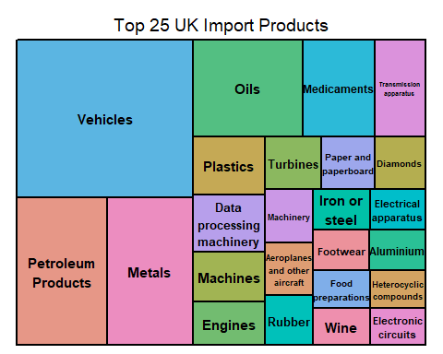

Slide 9
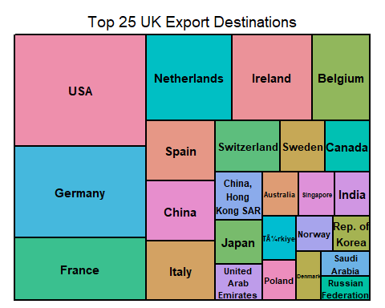

Slide 10
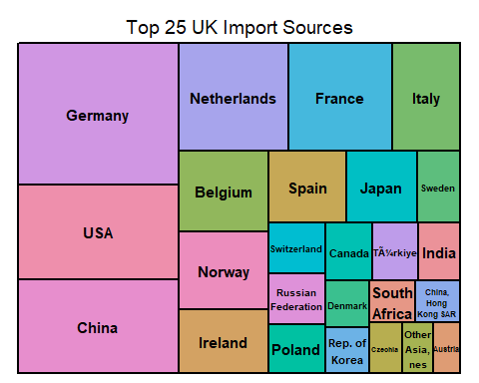

Slide 11
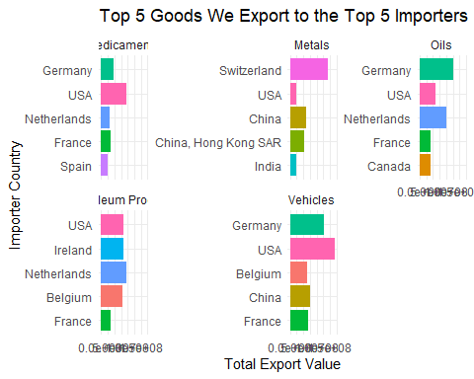

Slide 12
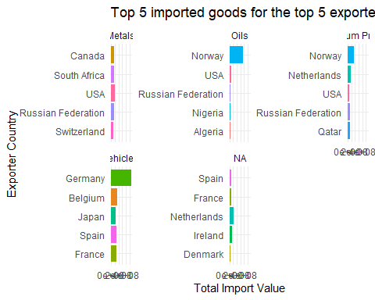

Slide 13
Overview of Methodology
Correlation Analysis
Explore how different products and trade partners move together
Identify strong relationships between key sectors (e.g., aerospace, energy)
Clustering
Group similar products based on trade patterns
Used K-means and network-based methods to uncover hidden structure
Deep Learning
Developed two neural network models to forecast future trade
One model for UK as exporter, another for importer
Embedded categorical variables and scaled numeric ones

Slide 14
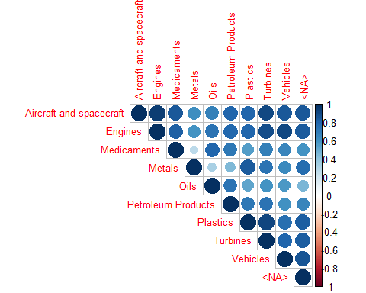
Correlation Between Top Export Products

Slide 15
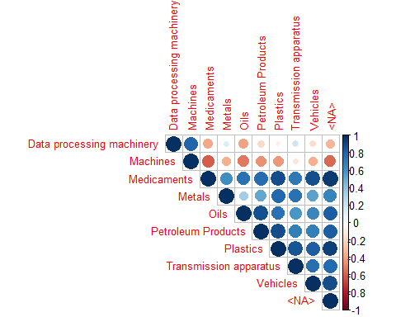
Correlation Between Top Import Products

Slide 16
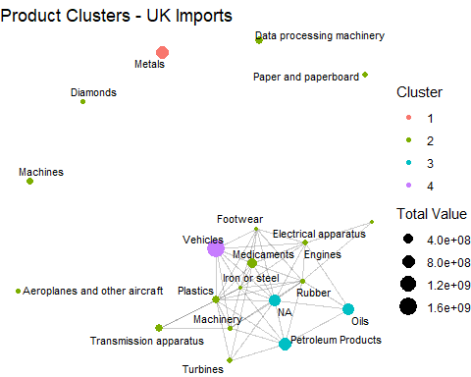

Slide 17
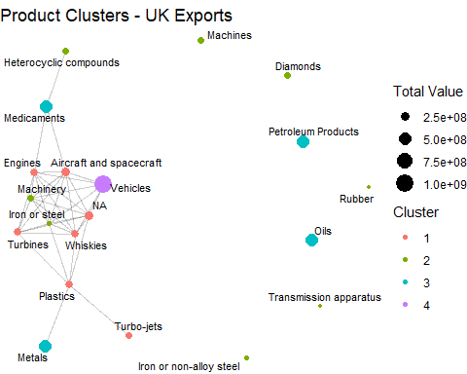

Slide 18
Deep learning
Deep learning is a type of machine learning that uses multi-layered neural networks to learn patterns in data.
Especially effective for large, complex datasets with non-linear relationships.
In this project:
Built two models using TensorFlow and Keras in R.
One for UK as exporter, one for UK as importer.
Inputs included trade partner, product type, and year.
Used embedding layers for categorical variables and dense layers for regression.
Trained over 30 epochs with mixed precision and batch size of 216.

Slide 19
Model comparison
To assess performance, deep learning forecasts were compared against traditional methods:
Logistic Regression
Simple, interpretable.
Struggles with complex, non-linear relationships in trade data.
Regression Trees
Handles non-linearity better.
Prone to overfitting and less smooth in forecasting.
Deep Learning Advantages
Captures hidden patterns in high-dimensional data.
Better generalization across products, partners, and time.
Outperformed traditional models on key accuracy metrics (e.g., MAE).

Slide 20
conlcusion
The project successfully explored whether UK trade—by total value, product, and partner—can be forecasted using data-driven techniques.
Key findings:
The UK’s trade deficit is long-standing and forecasted to widen.
Vehicle, pharmaceutical, and machinery sectors dominate exports.
Imports show strong reliance on Europe, China, and the USA.
Deep learning provided robust forecasts and outperformed simpler classifiers.
However, limitations like trend smoothing and lack of external variables affect realism.
Future improvements could include:
Incorporating economic indicators or policy variables.
Modeling shocks or regime changes explicitly.

